Slide 1
Knowledge Sharing on Trade & Investment Building Trade Capacity
ACP House Brussels
20/21 February 2018
Prepared By Colin. F Stringer

Slide 2
Trade Knowledge Sharing & Investment
Objectives – Program with SAME
Private Sector Competiveness Improved
Gap Analysis of the Regulatory & Policy Framework against best
Practice Models
Focus on building capacity to export to EU market-understanding EU
legislation and requirements of EU market
Identify opportunities into the future
Other TradeCom Support
Support given for Interim Economic Partnership Agreement
Important Complementary to each other to ensure no overlap
On-going support to MFAT on Trade Agreements such as Pacer Plus
Prepared By Colin. F Stringer

Slide 3
Knowledge Sharing on Trade & Investment
Environment
Samoa has Sound Broad Based Legislative framework within which the Private Sector Operates
Foreign Investment Act 2000 with amendment 2015
Codex Alimentarius Commission- Food Safety Standards
Food Labelling
PACER PLUS- Trade in Good & Services plus Investments
Personal Property Securities
Fair Trading ACT
Customs is gradually implementing Asycuda World with
increasing emphasis on Post Clearance Audits
Prepared By Colin. F Stringer

Slide 4
Knowledge Sharing on Trade & Investment
Private Sector Support Schemes
Pacific Horticultural & Agricultural Market Access
Supporting HACCP Program also investment in enhancing supply ie Driers
PHAMA
Private Sector Support Facility Funded by NZ & UNDP
Small G rants to Manufacturing
F
PSSF
Duty Concessions
Duty Concessions on importing of goods for manufacturing during start up phase. Limited to 1 year
SACEP
SABS
Agriculture Support Schemes
Prepared By Colin. F Stringer

Slide 5
Knowledge Sharing on Trade & Investment
Trade in Goods
Average Deficit over last 5 years ($700m)
The balance in trade & goods expected to modestly Improve over next 3 years with best case scenario of ($600m)
Main driver reduction in Mineral Imports (Renewable Energy) & increased volume of exports to $100m by 2020
Domestically improving volume, consistency & quality of supply
Prepared By Colin. F Stringer

Slide 6
Knowledge Sharing on Trade & Investment
Direction Samoa Exports
Export Destination
Pacific (Australia; NZ; AM Samoa; Fiji
Asia
North America
Europe
Total
2014/2016
76%
12%
10%
2%
1000%
Prepared By Colin. F Stringer

Slide 7
Knowledge Sharing on Trade & Investment
Export Plan Assumptions
China, Japan and Taiwan now account for nearly 10% exports &
growing
Increasing interregional trade in Pacific – Pacer Plus
Slow Progress Trade Agreements - China & Japan
impacting on growth of exports
Evolving IEPA with EU will support export growth
to that region
Prepared By Colin. F Stringer

Slide 8
SDS Key Outcome 5 –
Participation of Private Sector Development Enhanced
Doing Business in Samoa

Slide 9
Knowledge Sharing on Trade & Investment
Total export value for goods is estimated at SAT$ 100 million
by end ofFY2020/21
Prepared By Colin. F Stringer

Slide 10
Knowledge Sharing on Trade & Investment
Factors Impacting on Private Sector Enhancement
Supporting Change
Constraining Change
Technology/Interconnect
On line marketing
Electronic Documents
Market intelligence/
information
Quality Standards
Trade Agreements
Renewable Energy
Supply Constraints
Cost & Access to Finance
Support Schemes
Personal Property Securities
Payments Systems
Prepared By Colin. F Stringer

Slide 11
Knowledge Sharing on Trade & Investment
Four Pillars of SAME
Value Chain
Capacity
Building
Quality
Standards
Market
Devlmnt
Market Access/
Supplier
To
Customer
Trade Missions
Market Intelligence
Export Marketing
Export Awards
Geo Indicators
Training
Con Imp
Production
Technology
HACCP
ISO
Testing
Evidence
Prepared By Colin. F Stringer

Slide 12
Knowledge Sharing on Trade & Investment
Public Private dialogue improving
Relationship with Ministry Commerce, Industry & Labour
SAME hold permanent place on government committees
representing private sector
Also represented on number of Statutory Board such as SQA
Slowly increasing influence on government policy eg Export Plan
Area for Discussion Direct Investment Private Sector
Prepared By Colin. F Stringer

Slide 13
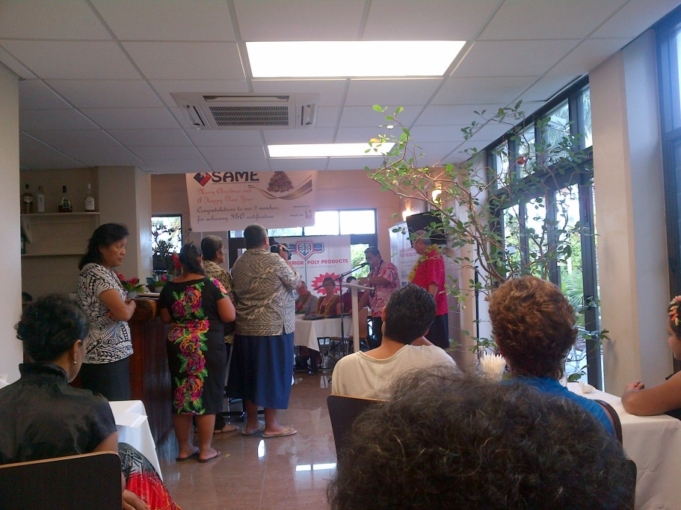
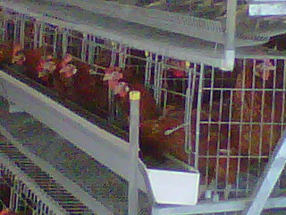
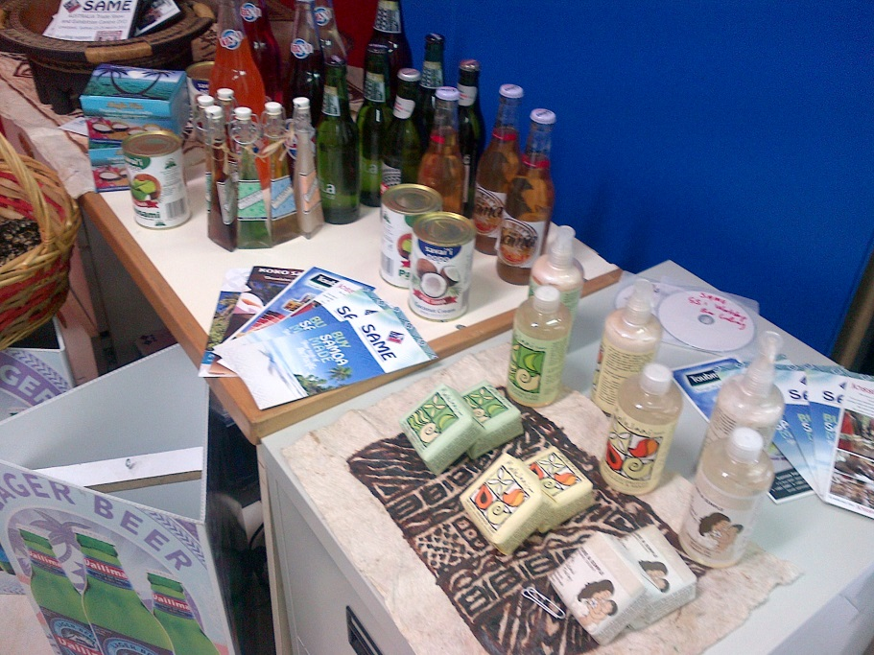
Product quality
HACCP Certification under SAME: started 2014
10companies accredited by December 2017
Program is ongoing/ 16+ companies.
Tanumapua poultry farm
SAME industry products

Slide 14
Knowledge Sharing on Trade & Investment
Markets
Existing
New
Cocoa Virgin Coconut Oil | Nonu Juice Fish Ginger | Breadfruit Kava Innovative –Value Added Products
Coconut Cream | Beer Coconut Oil | Agri Based Products
Water | Taro Copra Meal | Handicrafts
New
Products
Existing
Pacific Oil made million dollar Investment Coconut Oil Refining
Prepared By Colin. F Stringer

Slide 15
Knowledge Sharing on Trade & Investment
Interim Outputs of Trade Com Program
Gap Analysis Completed-Number of conformity issues
Evaluation of Testing Laboratory showed limitations in
range and effectiveness of tests. Many tests done off shore
Production of test questionnaire guiding companies through
EU requirements
Site Visits of companies exporting to evaluate readiness
Final Seminar program agreed. EU regional representatives to
be invited
Prepared By Colin. F Stringer

Slide 16
Knowledge Sharing on Trade & Investment
Opportunities Going Forward
Capacity Building- Better understanding of requirements export to EU
Completion of Standards Manual
Support for opening markets for specific Niche Products
Potential for Cosmetic Products from coconut oil
Strengthening the Testing Capabilities of Government Testing
Laboratory
Support for Trade Mission or direct contact with Importers In the EU
Consideration Geographic indicators for newer Export Products
Prepared By Colin. F Stringer

Slide 17
Knowledge Sharing on Trade & Investment
Major Initiative by SAME to encourage and Reward Excellence in Exporting
Final Seminar of current project will take place and aligned with Export Awards event 27 April 2018
Prepared By Colin. F Stringer

